Slide 1
Handwriting Analysis
Using convolutional neural networks

Slide 2
AGENDA
Objective
MNIST
TrOCR
CNN
Result

Slide 3
TIMELINE
Preprocessing
Data
TROCR
Result
Step 1
Step 3
Step 5
MNIST
CNN
Step 2
Step 4

Slide 4
objective
To develop a Convolutional Neural Network (CNN) capable of determining whether an image of handwriting was produced by a left- or right-handed person. The analysis will include Mazaal’s TrOCR for feature extraction and CNN to classify handwriting into left-handedness or right-handedness.

Slide 5
MNIST
preprocessing, augmentation, normalization

Slide 6
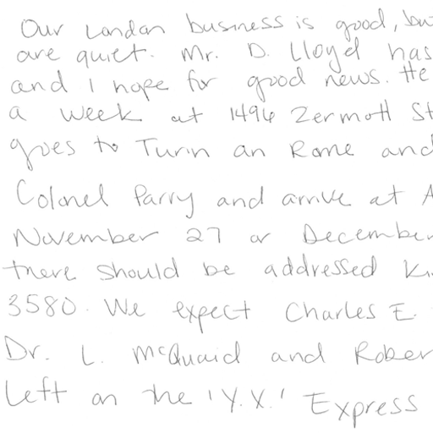
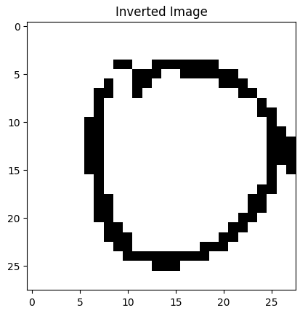
Preprocessing
Source Data 12,807 files
Source jpeg 4,261 images
Convert png to jpeg
Used Otsu’s method for separating pixels based on intensity values

Slide 7
augmentation
Q | B2B | SUPPLY CHAIN | ROI | E-COMMERCE
Q1 | 4.5 | 2.3 | 1.7 | 5.0
Q2 | 3.2 | 5.1 | 4.4 | 3.0
Q3 | 2.1 | 1.7 | 2.5 | 2.8
Q4 | 4.5 | 2.2 | 1.7 | 7.0

Slide 8
Normalization
“
”
data

Slide 9
Mazaal’s trocr
Slant of handwriting
Stroke patterns
Pressure distribution
Feature extractions
Baseline alignment
Space and size
Curvature and smoothness
Letter formation

Slide 10
Handedness
transcript

Slide 11
Training a custom model
dataset
MNIST
DESIGN
trOCR
Train
Writing samples of both left-handedness and right-handedness
Make everything the same
Coordinate e-business applications
Feature extraction
Convoluted Neural Network for training a custom classification model

Slide 12
Model architecture
CNN
50 epochs
Develop winning strategies to keep ahead of the competition​
Capitalize on low-hanging fruit to identify a ballpark value​
Visualize customer directed convergence
Iterative approaches to corporate strategy
Establish a management framework from the inside

Slide 13
HOW WE GET HERE
ROI
NICHE MARKETS
Supply CHAINS
Envision multimedia-based expertise and cross-media growth strategies
Visualize quality intellectual capital
Engage worldwide methodologies with web-enabled technologies
Pursue scalable customer service through sustainable strategies
Engage top-line web services with cutting-edge deliverables
Cultivate one-to-one customer service with robust ideas
Maximize timely deliverables for real-time schemas

Slide 14
Result
99% accuracy

Slide 15


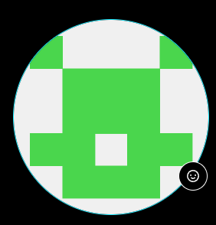

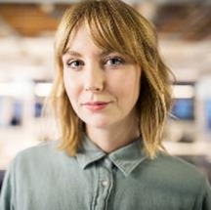


MEET OUR TEAM
Jordan graves
Jeff gary
Toni akande
Paige manguiat
​
​

Slide 16
THANK YOU ☺
Group 2
Jordan Graves, Jeff Gary, Toni Akande, Paige Manguiat
https://github.com/JGraves79/Handwriting_CNN.git
Vanderbilt University Data Analytics Bootcamp

